Slide 1
Technical Challenge Craft Demo
Presented By: Hari Panjwani

Slide 2
Introduction
About Myself
Northeastern University M.S in Information Systems Java, Database Design, Spring MVC, Hibernate
Goldman Sachs Analyst & Developer JAVA, MySQL, Maven
Oracle Corporation Software Developer Agile Methodology
VIT University
B.Tech – Information Technology Object Oriented Designing, Data Structure and Algorithm

Slide 3
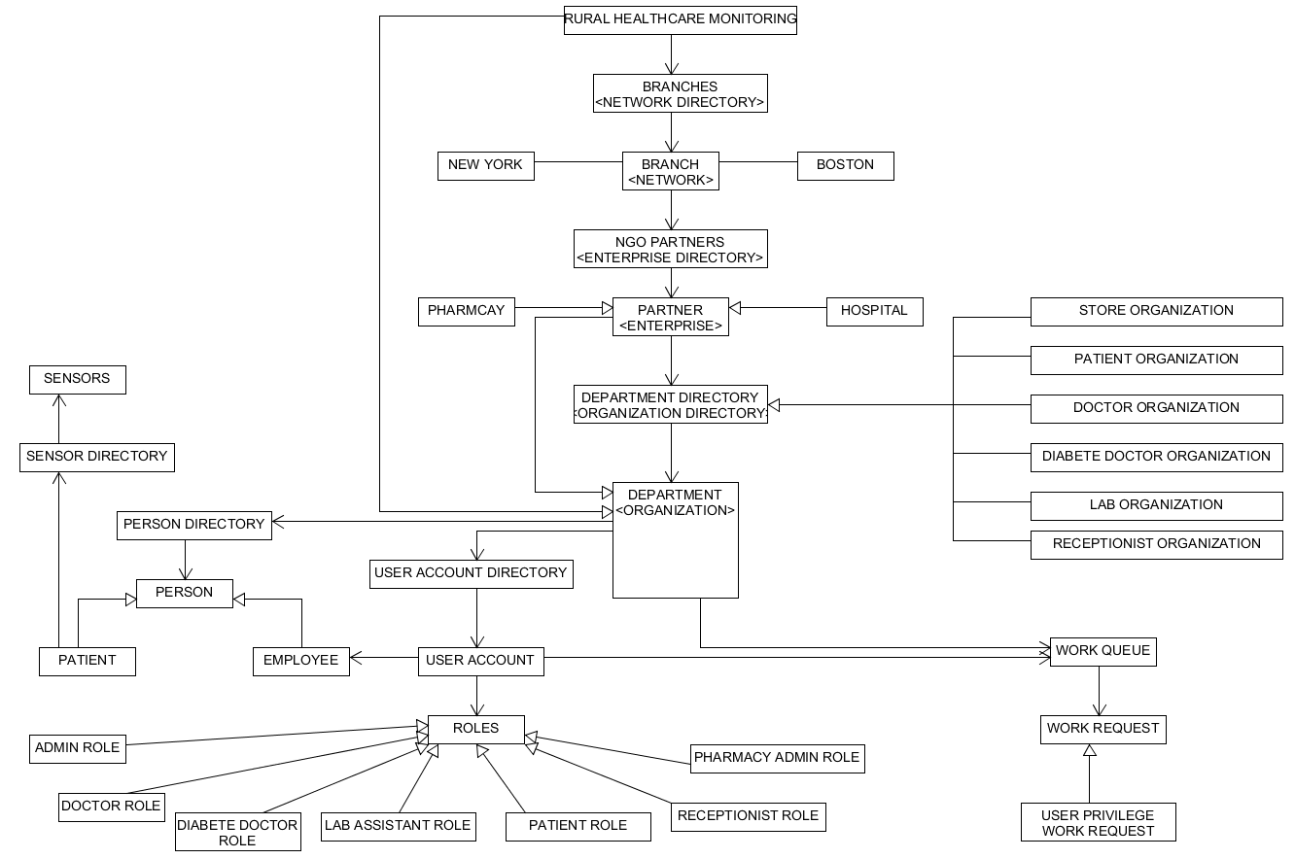
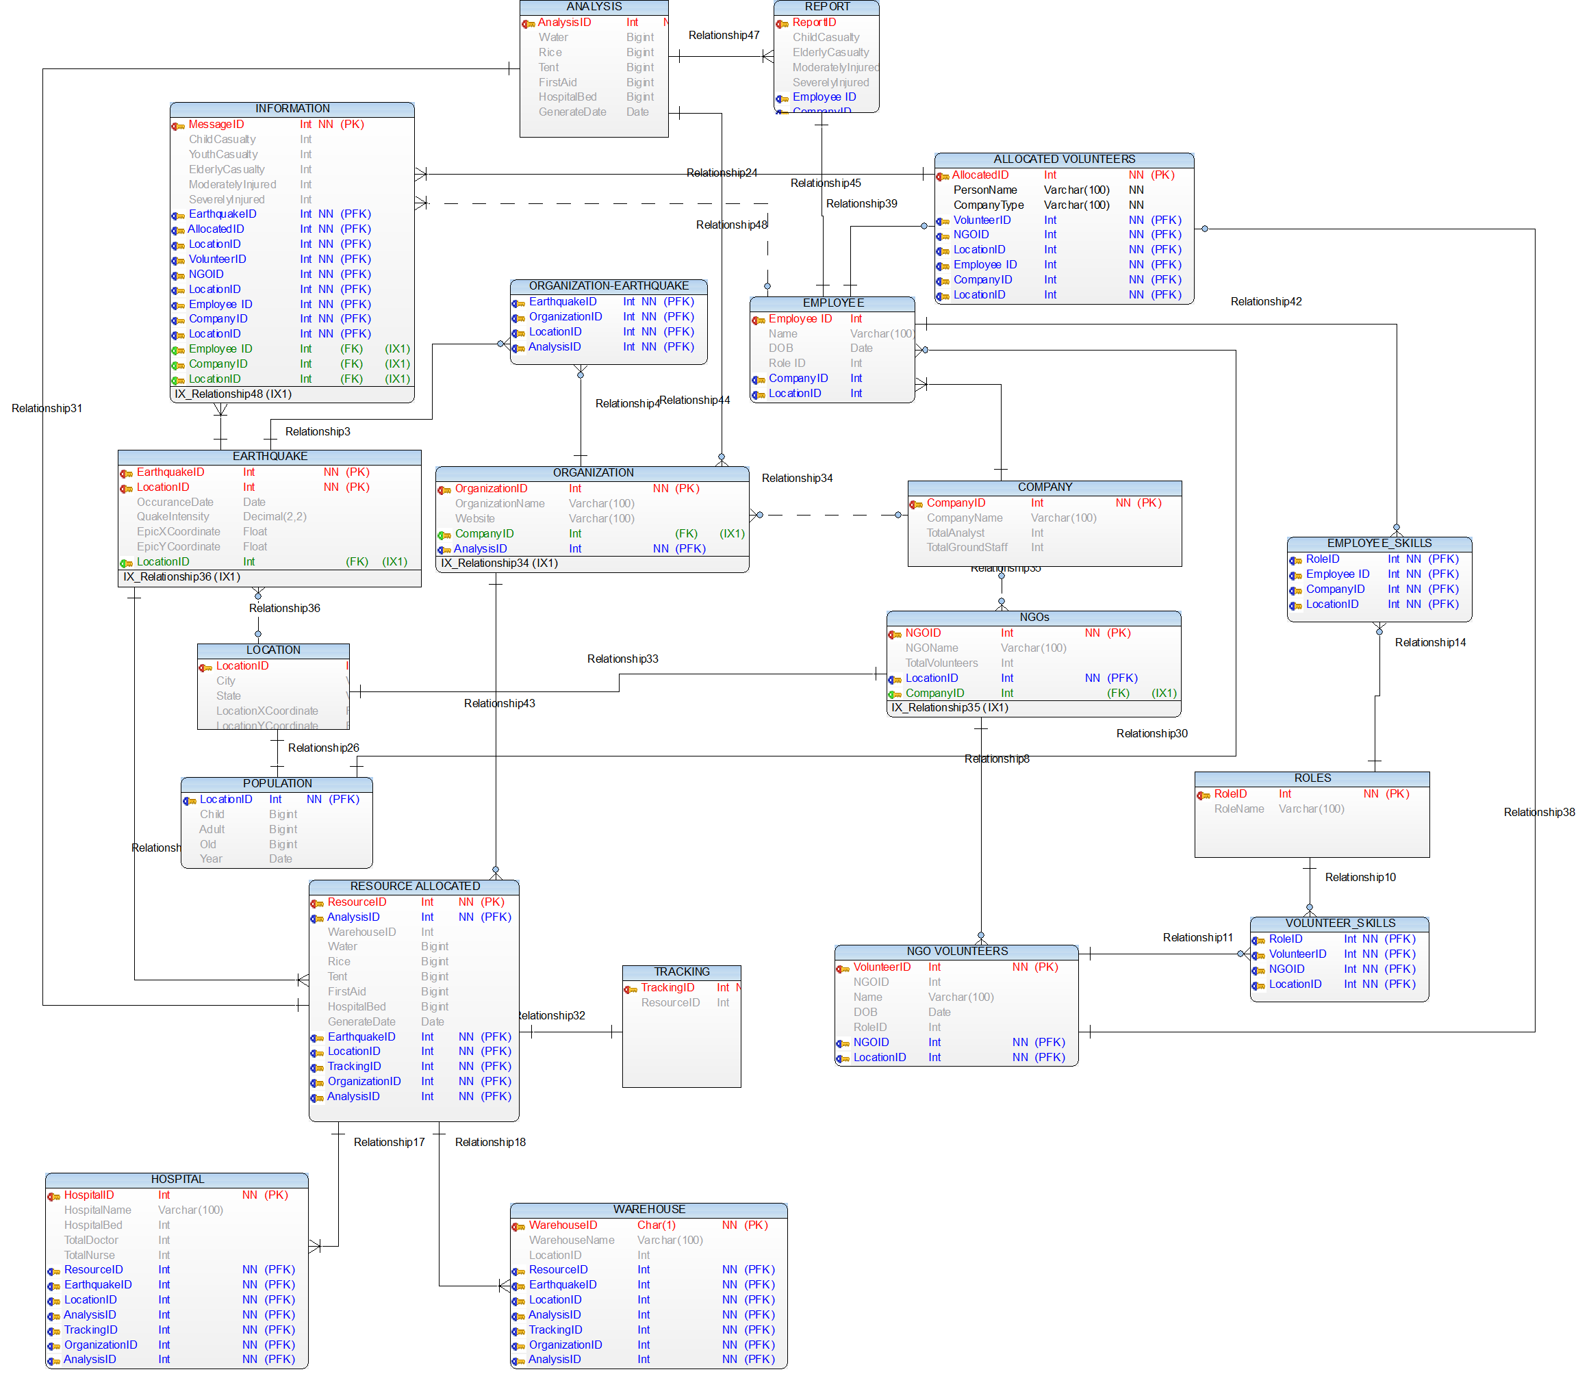
Portfolio 1.IoT based Rural Healthcare 2.Resource allocation during Disaster

Slide 4
3.Report Generation Tool
Designed and developed an application to automate the documentation publishing process.
Implemented Business Intelligence operations based on which PDF and Excel reports were generated.
Benefits Time reduction Increased productivity

Slide 5
Technical Challenge Craft Demo
Problem Statement
Implement a solution which returns the combined list of countries and populations from two different data sources.
Solution
Used Lambda Expression and Stream to merge the data from two different data sources
Basic Concepts
Collections
List
Linked List
Set
Hash Map
Linked Hash Map

Slide 6
Analysis
Java 8
Lambda expression - are set of new syntactical capabilities that let Java developers work as functional programmer.
Stream - a new way of managing, traversing and aggregating collections.
Demo
Inner Class
Predicate
Lambda Expression
Stream

Slide 7

Solution
Code Explanation
Two different data sources are present (API and Database).
Establish the connection with database and API.
Retrieve the country’s population data from both data sources.
Merge two list and remove the duplicates.

Slide 8
THANK YOU

